Slide 1
Topic 3
Recursion
【See Chap17.1 in the textbook】

Slide 2
Recursion
A powerful problem-solving strategy that is defined as any solution technique in which large problems are solved by reducing them to smaller problems of the same form.

Slide 3
Recursion vs. step-wise refinement
Both strategies involve decomposition.
What makes recursion special is that the sub-problems in a recursive solution have the same form as the original problem.

Slide 4
A simple illustration of recursion
Problem：Imagine that you have been appointed as the funding coordinator for a large charitable organization. Your job is to raise $1,000,000 in contributions so that the organization can meet its expenses.
Strategy：
void CollectCountributions (int n) {
if (n <= 100) {
Collect the money from a single donor.
} else {
Find 10 volunteers.
Get each volunteer to collect n/10 dollars.
Combine the money raised by the volunteers.
}
}
CollectCountributions (n / 10);

Slide 5
The Factorial function(1)
Problem：Compute the factorial of integer n — n!
Strategy1(using loop): n! = 1*2*3*……*(n-1)*n
int Factorial (int n)
{
int product, i;
product = 1;
for (i = 1; i <= n; i++) {
product *= i;
}
return (product);
}

Slide 6

The Factorial function(2)
Strategy2(using recursion):
int Factorial (int n)
{
if (n == 0) {
return (1)；
} else {
return (n*Factorial(n-1));
}
}

Slide 7
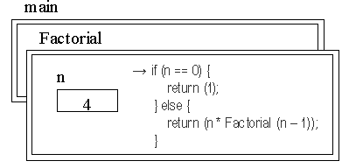
The frames of Factorial function call(1)
main:
fact = Factorial(4);

Slide 8
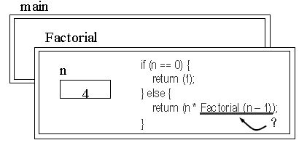
The frames of Factorial function call(2)
Factorial(4):
call: Factorial(3);

Slide 9
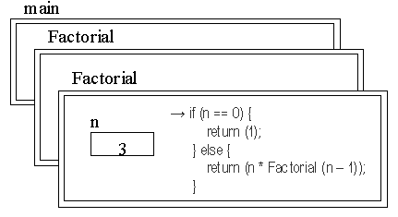
The frames of Factorial function call(3)
Factorial(3):
execute: Factorial(3);

Slide 10
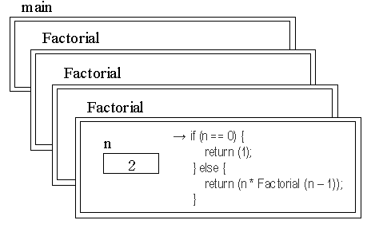
The frames of Factorial function call(4)
Factorial(2):
execute: Factorial(2);

Slide 11
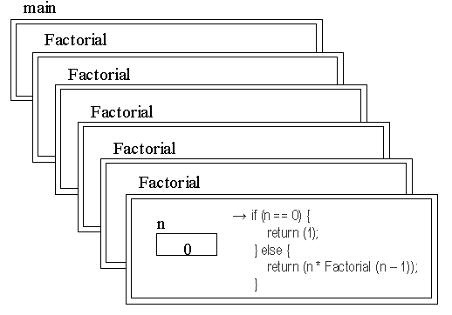
The frames of Factorial function call(5)
Factorial(0):
execute: Factorial(0);

Slide 12
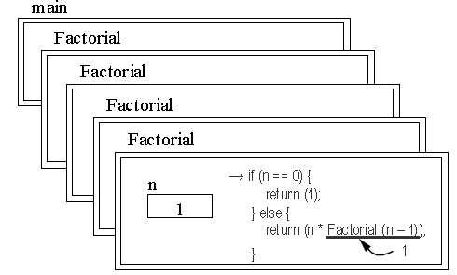
The frames of Factorial function call(6)
Factorial(1):
return 1*1;

Slide 13
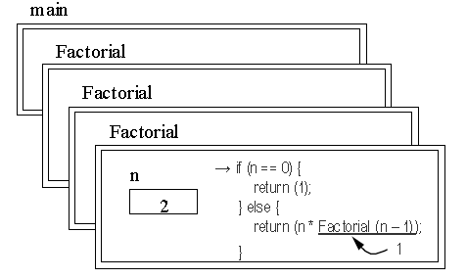
The frames of Factorial function call(7)
Factorial(2):
return 2*1;

Slide 14
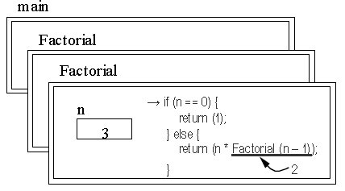
The frames of Factorial function call(8)
Factorial(3):
return 3*2;

Slide 15
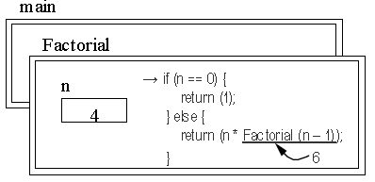
The frames of Factorial function call(9)
Factorial(4):
return 4*6;

Slide 16
The recursive leap of faith
When you think about a recursive program, you must be able to put the underlying details aside and focus instead on a single level of the operation.
At that level, you are allowed to assume that any recursive call automatically gets the right answer as long as the arguments to that call are simpler than the original argument in some respect.
Learning to assume that any simpler recursive call works while you are designing a recursive function is an essential programming strategy called the recursive leap of faith.
Looking more than one level down in a recursive function inevitably makes the problem harder to solve.

Slide 17
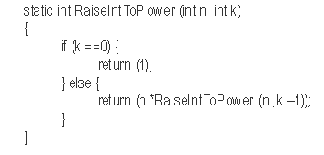

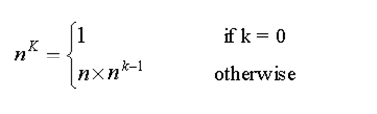
The recursive paradigm
The body of the typical recursive function has the following paradigmatic form:
if (test for simple case) {
return (simple solution computed without using recursion);
} else {
return (recursive solution involving a call to the same function);
}
The function that raises an integer n to the kth power:

Slide 18
The conditions of using recursion
The problems of computing a factorial or raising a number to a power have natural recursive solutions because the problems meet the following conditions:
You can identify simple cases for which the answer is easily determined.
You can apply a recursive decomposition to break down more complicated instances of the problem into simpler problems of the same type, which you can then solve by applying the same solution technique.

Slide 19
Generating permutations
Problem: A large part of playing many word games is the ability to rearrange a set of letters to form a word.
For example, a program would be useful to have a facility for generating all possible arrangements of a particular set of tiles.
In word games, such arrangements are generally called anagrams.
In mathematics, they are known as permutations.

Slide 20
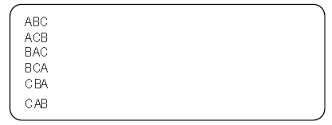
ListPermutations problem
For example, if you call
ListPermutations (“ABC”);
your program should display the six arrangements of “ABC”, as follows:

Slide 21
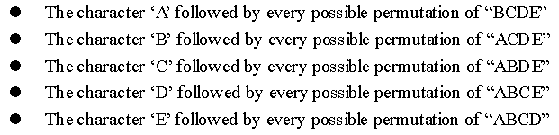
ListPermutations problem
A solution of ListPermutations (“ABCDE”) using recursive strategy:
More generally, to display all permutation of a string of length n, you can take each of the n characters in turn and display that character followed by every possible permutation of the remaining n – 1 characters.

Slide 22
ListPermutations problem
A prolem about above recursive strategy:
The recursive subproblem does not have exactly the same form as the original, which is a requirement for a recursive solution.
Need to transform the problem slightly so that the recursive subproblems are the same all the way along.
Define a new procedure PermuteWithFixedPrefix that generates all permutations of a string with the first k letters fixed.

Slide 23
PermuteWithFixedPrefix function
static void PermuteWithFixedPrefix(string str, int k)
{
int i;
if (k == StringLength(str)) {
printf("%s\n", str);
} else {
for (i = k; i < StringLength(str); i++) {
ExchangeCharacters(str, k, i);
PermuteWithFixedPrefix(str, k + 1);
ExchangeCharacters(str, k, i);
}
}
}

Slide 24
Wrapper: ListPermutations function
static void ListPermutations(string str)
{
PermuteWithFixedPrefix(str, 0);
}
static void ExchangeCharacters(string str, int p1, int p2)
{
char tmp;
tmp = str[p1];
str[p1] = str[p2];
str[p2] = tmp;
}

Slide 25
Thinking recursively
More than any other aspect of programming, learning to use recursion requires you to think about the programming process holistically.
Maintaining a holistic perspective can reduce the complexity of most recursive programs to a point at which you can comprehend the solution.
Your uncertainty about the correctness of your solution forces you down the reductionistic path, the mass of details will almost certainly make it impossible for you to understand the high-level structure of the solution.
Thinking about recursive problems in the right way does not come easily. Learning to use recursion effectively requires practice and more practice.

Slide 26
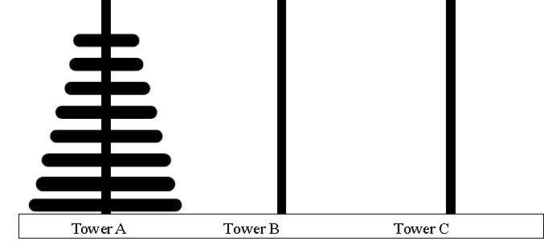
Case study: Towers of Hanoi problem
There are three towers, one of which contains a set of disks arranged in decreasing order of size as you move from the base of the tower to its top, as illustrated in the following diagram:
The goal is to move the entire set of disks from Tower A to Tower B, following these rules:
a. You can place a disk on any tower.
b. You can only move one disk at a time.
c. You can never place a larger disk on top of a smaller disk.

Slide 27
Case study: Towers of Hanoi problem
Basic decomposition : Hanoi(n, A, B, C)
First, move the top n-1 disks form tower A to tower B;
Second, move the last one disk form tower A to C directly;
Third, move the n-1 disks form tower B to tower C.
The condition of stop decompose: n == 1
Pseudocodes:
Hanoi(n, A, B, C) {
if (n == 1) Move(A, C);
else {
Hanoi(n-1, A, C, B);
Move(A, C);
Hanoi(n-1, B, A, C);
}

Slide 28
Case study: Towers of Hanoi problem
#include <stdio.h>
#include "genlib.h"
void Hanoi(int, string, string, string);
void Move(string, string);
main()
{
int n;
printf("Enter number of disks: ");
n = GetInteger();
if (n <= 0) return 0;
Hanoi(n, "A", "B", "C");
}
void Hanoi(int n, string one, string two, string three)
{
if (n == 1) {
Move(one, three);
} else {
Hanoi(n-1, one, three, two);
Move(one, three);
Hanoi(n-1, three, one, two);
}
}
void Move(string from, string to)
{
printf("%s -> %s\n", from, to);
}

Slide 29
Home Work（2题）：
Programming exercises 5 and 6
in Pp641-645 of the textbook.

Slide 30
Project （1题）：整数划分问题
编程序求某一个正整数的所有划分数。如输入6，则输出：（要求输出不能重复）
6 = 5+1
6 = 4+2
6 = 4+1+1
6 = 3+3
6 = 3+2+1
6 = 3+1+1+1
6 = 2+2+2
6 = 2+2+1+1
6 = 2+1+1+1+1
6 = 1+1+1+1+1+1

Slide 31
The End

